Slide 1

Growth Mindset Workshop for Families

Slide 2
Our journey so far….
Looked at our children and the effects of lockdowns
Research and reading
Forest School introduced to improve Learning Behaviours and relationships
Ian Brealey
Workshops
Growth Mindset
Sharing with families
Review school practce
Embed Growth Mindset
Audited Growth Mindset
Review and audit!
Reviewed Forest School Impact

Slide 3
What do we know about our children now?
Ian could see the resilience building in our children– only 1.5% of children said - I can’t when given a challenging task: this is not the picture in other school he has visited (400 of them!)
Ian fed back that the children across the school showed incredible respect whilst learning – especially of others.
‘I have got ideas that others listen to, I didn’t suggest things before but I have at Forest School’
Y6 Pupil
‘ I have improved my fear of things - I loved making the stick and whittling it’
Y5
‘I feel braver now to talk in the classroom’
Y5
Ian could ‘feel’ the impact of our 3R Behaviour Policy
Forest School helps me focus in the classroom too
Y6
‘Forest School has made me more adventurous – in maths I like to go further’ Y6
Our audit showed that only
6% of children think mistakes are not part of learning.
Our audit showed that
45 % would still go to an adult first when they are stuck on a challenge….this is our next step!
Our audit showed that
70% liked to be given ‘tricky’ learning – sometimes.

Slide 4
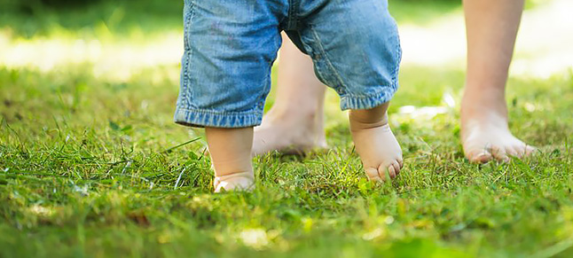
Children are not BORN clever.
They are NOT born with a FIXED MINDSET.
They are BORN ready to learn.
One step at a time.

Slide 5
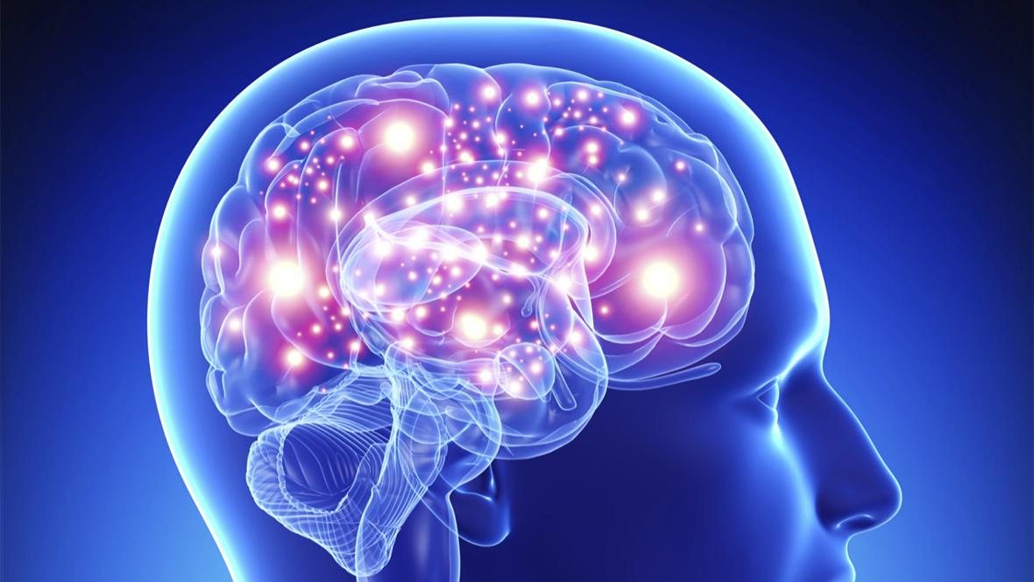
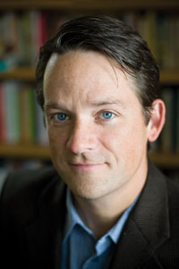
Back in 2022 parents and teachers wanted kids to learn, but somehow they didn’t bother teaching kids the most important part — how the learning machine actually works. What the heck were those people thinking?
Daniel Coyle

Slide 6
Brain cells are called neurons.
A baby is born with 86 billion neurons, but it is only a ¼ of the size of an adult brain.
As we develop and learn, the neurons can create pathways – synapses.

Slide 7
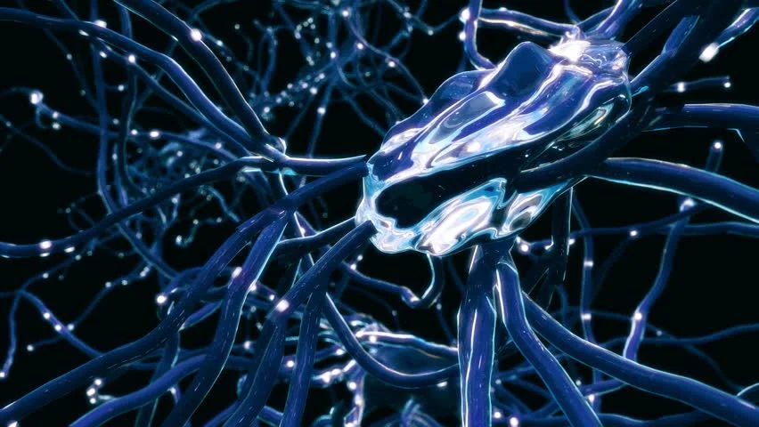
Adults 500 trillion synapses.
A baby has 50 trillion synapses.
A 3 year old 1000 trillion synapses.
By 5 years old a child’s brain has increased to 90% of it’s potential volume – brain completes growth by age 25 …… but new synapses don’t stop being made – the brain ‘prunes’ synapses we no longer use or need.

Slide 8
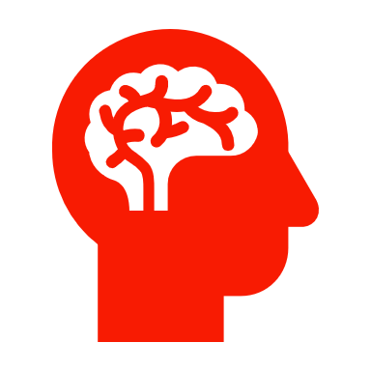
What does Growth Mindset mean?

Slide 9
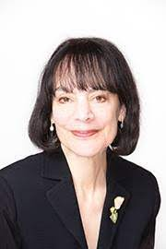
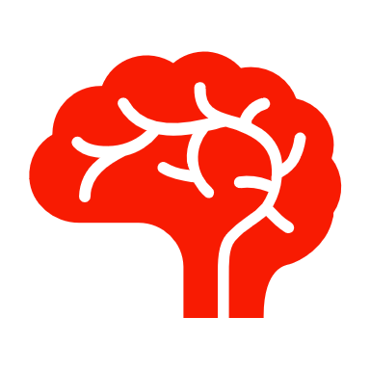
“In a growth mindset, people believe that their most basic abilities can be developed through dedication and hard work—brains and talent are just the starting point. This view creates a love of learning and a resilience that is essential for great accomplishment.” ( Dweck, 2015)

Slide 10
What does a Growth Mindset look like compared to a Fixed One?

Slide 11
Fixed Mindset focuses on Performance outcomes
There is only one goal in the task.
I can succeed or fail.
I am clever so I can achieve the task.
I am not clever so I will not be able to achieve the task.
I do not know the correct answer – I will look stupid.
I will never be able to be as good as my friend.
If I don’t try something new, I can’t look stupid.
When I make a mistake I have failed.
I want to impress adults with how clever I am.
Growth Mindset focuses on ‘learning’ goals
I will take lots of steps in this learning – it will take time.
I will learn from the mistakes I make
I need to put in effort to help me tackle the learning
I will persevere when I meet challenges
I will contribute my answer and learn from others too
I have to practice to get better – so did my friend
Every time I try something new, I grow my brain
Failing is part of learning: failure is not trying
I want to improve my learning for myself – not adults

Slide 12
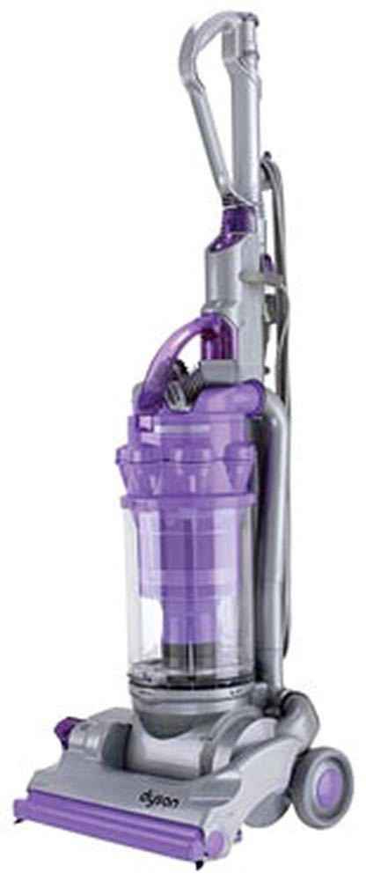

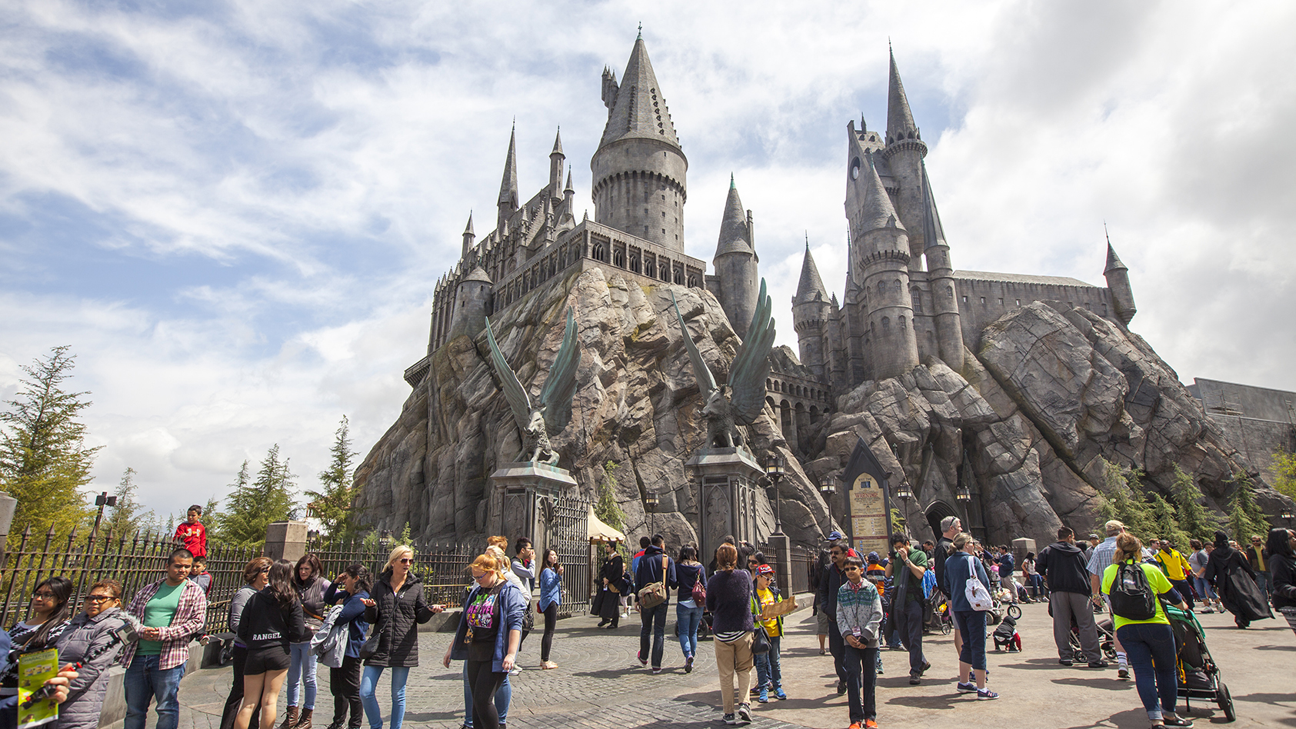
Failing, is part of the learning process: Failure is not even trying.
J.K Rowling, James Dyson and Thomas Eddison showed incredible Growth Mindset!
If JK Rowling hadn’t submitted Harry potter to 12 separate publishers = no Harry Potter world in Los Angeles.
If James Dyson hadn’t made 5’127 changes to his hoover = we would still have hoover bags
If Thomas Eddison hadn’t ‘found 10’000 ways that the lightbulb wouldn’t work: life would be very different.

Slide 13
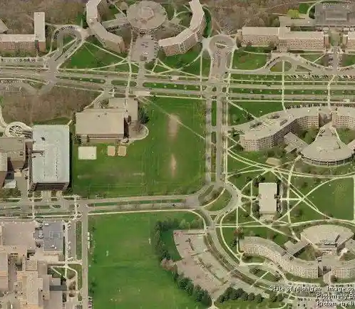
To support and enable the creation of new synapses….the learning environment and curriculum must:
Be a safe place where children can make mistakes
Provide the right amount of challenge and varied opportunities
Provide opportunities to fail and try again
Encourage children to talk about ‘how they learn’
Supportively inform learners how they can improve
Be a place where adults can make mistakes too
Be a place where adults are seen as learners

Slide 14
Because environment factors and communication are central to making new synapses we need to think where a child spends the majority of their time .
76% of a child’s conscious hours are spent in the family home – not school!
We want to be able to support and work with families to ensure you are able to help provide the right conditions and environment for children to build the synapses – have growth mindset and be amazing learners!

Slide 15
Language to avoid……….
You’re so clever at… You’re so intelligent at…
You’re lucky, you’re gifted at...and it’s so easy for you to…
Don’t worry about your score, did you get more than x child?
Ah...you made a mistake, how many times have we told you to get it right first time/ focus more?
Your brother found maths* easy …you are better at English!

Slide 16
Language to use plenty of….
I’ve noticed the effort you’re putting into…
All of your hard work and practise is resulting in progress in…
I’m proud of how committed you have been to learning…
Are you clear what you need to do to improve your learning next time?
You made a mistake that OK. You can learn from it

Slide 17
Supporting Growth Mindset
Embrace mistakes – yours included! What can you learn from a situation – share that with your child.
Check your own mindset: ‘ I was not good at maths so they won’t be either’.
Don’t steam roller the tricky bits of life – children’s brains grow because of ALL experiences
Be mindful of looking through your own ‘lens’ at a child’s world’, when they meet experiences for the first time
Be mindful of telling your child they clever for ‘outcomes only’.
Children only ‘learn’ and build synapses when they feel safe– if ‘berated’ for ‘outcomes’ and not recognised for effort
Praise needs to be focused on the learning behaviours: effort / perseverance / resilience / motivation / adaptability
Be mindful of telling your child they are perfect – this pressure may make them sacred of mistakes and failing
Lead the way – time to try something new – showcase how you take small steps as a learner.
‘reframe’ your child’s thinking when they are showing a fixed mindset – enabling it further is detrimental

